Slide 1



Ilia Poliakman(id 19021406) | 01.06.2023 | BSc Computing Project | Superviser: Mohamed Bettaz
Online Study Photography Platform
Learn the basics of photography!
A training platform that combines theoretical and practical methods of teaching photography

Slide 2


Introduction
What is LensLab?
LensLab is a web-based application that combines theoretical lessons and practical camera simulations to help users improve their photography skills and knowledge.
Project Motivation
LensLab was developed by an experienced member of the Lumiere Society of Photographers, who, as a semi-professional photographer, recognized the need for a user-friendly and comprehensive online learning platform in the field of photography that addresses the limitations of existing resources and offers a practical approach to photography education.
Ilia Poliakman(id 19021406) | 01.06.2023 | BSc Computing Project | Superviser: Mohamed Bettaz

Slide 3

Table of Contents
Project Objective
3
Research & Methodology
3
Design & Interface
3
Active Development
3
Testing & Deployment
3
Recommendations
3
Conclusion and Q&A
3
Ilia Poliakman(id 19021406) | 01.06.2023 | BSc Computing Project | Superviser: Mohamed Bettaz

Slide 4

A training platform that combines theoretical and practical methods of teaching photography
Project Objective
Learn the basics of photography!
Ilia Poliakman(id 19021406) | 01.06.2023 | BSc Computing Project | Superviser: Mohamed Bettaz

Slide 5

Problem
Problem
Most of online resources are limited to study basic photography from both theoretical and practical perspectives.
Solution
Develop a photography training platform that combines theory and practice to empower aspiring photographers with comprehensive knowledge and hands-on experience.
Ilia Poliakman(id 19021406) | 01.06.2023 | BSc Computing Project | Superviser: Mohamed Bettaz

Slide 6

A training platform that combines theoretical and practical methods of teaching photography
Research & Methodology
Learn the basics of photography!
Ilia Poliakman(id 19021406) | 01.06.2023 | BSc Computing Project | Superviser: Mohamed Bettaz

Slide 7
Methodology
Data Collection
Data Analysis
Surveys
Quantitative Analysis
Focus Groups and Interviews
Qualitative Analysis
Ethical considerations were carefully addressed throughout the research process. Informed consentwas obtained from all participants, ensuring their voluntary participation and safeguarding theirconfidentiality. Participants were assured of the anonymity and privacy of their responses. Addi-tionally, the research adhered to the ethical guidelines set forth by the appropriate institutionalreview board
Ilia Poliakman(id 19021406) | 01.06.2023 | BSc Computing Project | Superviser: Mohamed Bettaz

Slide 8
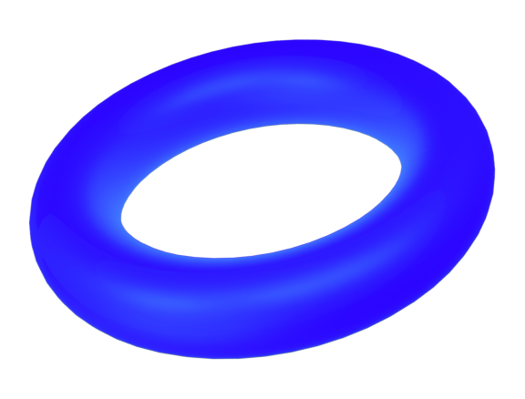
Research
Search for existing alternatives
UX Surveys
Focus Groups
Client Consultaions
Technical Consultaions
Scientific papers
Ilia Poliakman(id 19021406) | 01.06.2023 | BSc Computing Project | Superviser: Mohamed Bettaz

Slide 9
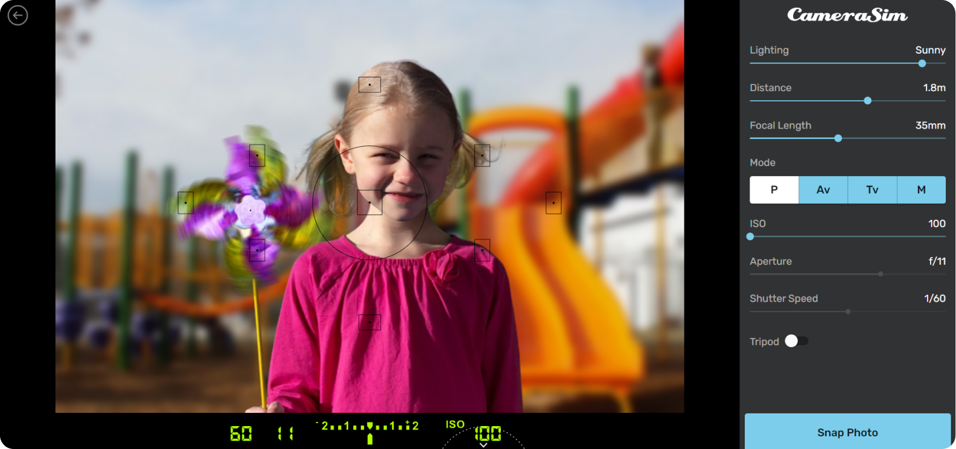
Existing Alternatives
CameraSim
Ilia Poliakman(id 19021406) | 01.06.2023 | BSc Computing Project | Superviser: Mohamed Bettaz

Slide 10
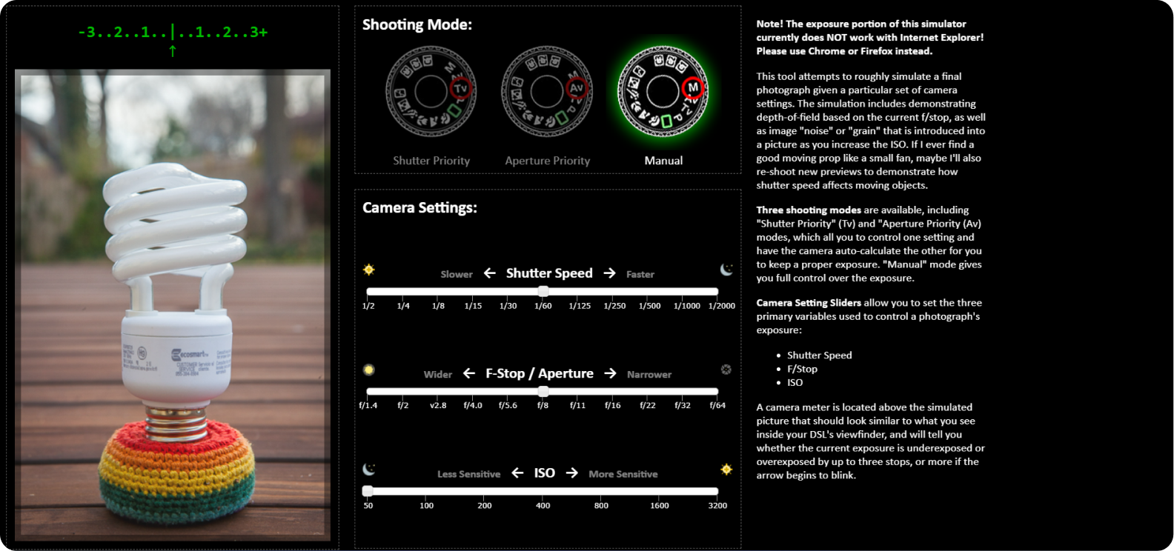
Existing Alternatives
Exposure Simulator
Ilia Poliakman(id 19021406) | 01.06.2023 | BSc Computing Project | Superviser: Mohamed Bettaz

Slide 11

Requirements
UI/UX
Client’s Requests
Visually appealing and intuitive interface.
Immersive experience through interactive elements and animations.
Seamless and intuitive navigation for easy studying.
Simple language and brief explanations to the tutorials coordinated with experienced Lumiere photographers
Accurate simulation of the effect of camera settings on image quality in accordance with established principles of photography and industry standards.
Accessibility for all users, including people with disabilities, subject to the recommendations for ensuring Internet accessibility. It should also work seamlessly in various web browsers and operating systems.
LensLab should be designed for future expansion, allowing for the addition of new features. The codebase should be well-structured, modular, and easy to maintain for updates and bug fixes.
Functional
Realistic camera simulator with accurate settings and effects.
Exposure algorithm to evaluate aperture, shutter speed, and ISO
Implementation of a photo evaluation system for feedback on composition, exposure, and more.
Interactive tutorials inside of simulator to help beginner photographers learn basic skills.
Ilia Poliakman(id 19021406) | 01.06.2023 | BSc Computing Project | Superviser: Mohamed Bettaz

Slide 12
Papers for Development
Abidin, M., Alkaabi, E., Razak, A. (2021). Proof of Concept: Effectiveness of PhotographyTraining Simulator during COVID-19. International Society for Technology, Education, andScience. Retrieved from ERIC database. Abidin et al. (2021)
brahmov, S. L., Ronen, M. (2008). Double blending: online theory with on-campus practicein photography instruction. Innovations in Education and Teaching International, 45 (1), 3-14. Abrahmov and Ronen (2008)
Sun, Y., Liu, L., Li, Q. (2010). Design and development of 3D virtual DSLR camera Basedon VRML and JavaScript. In 2010 5th International Conference on Computer Science &Education (pp. 1380-1384). IEEE. Sun et al. (2010)
Adams, A., Hamilton, D. (2018). Understanding Camera Simulators: A Comparative Anal-ysis. Journal of Photography Education, 42 (2), 87-102. Adams and Hamilton (2018)
Smith, J., Johnson, R. (2019). Exploring the Effectiveness of Virtual Photography Simulatorsfor Skill Acquisition. International Journal of Photography Studies, 15 (3), 45-62. Smith andJohnson (2019)
Ilia Poliakman(id 19021406) | 01.06.2023 | BSc Computing Project | Superviser: Mohamed Bettaz

Slide 13

A training platform that combines theoretical and practical methods of teaching photography
Design & Interface
Learn the basics of photography!
Ilia Poliakman(id 19021406) | 01.06.2023 | BSc Computing Project | Superviser: Mohamed Bettaz

Slide 14
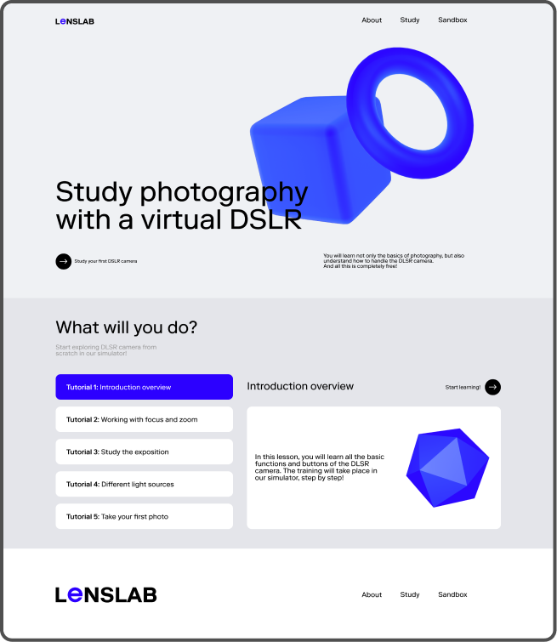
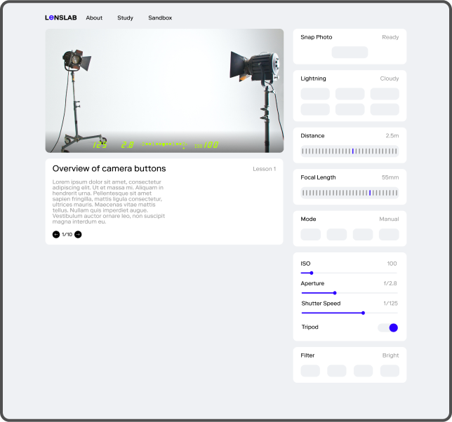
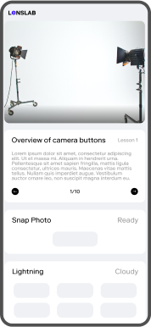
Initial Design
LensLab
Ilia Poliakman(id 19021406) | 01.06.2023 | BSc Computing Project | Superviser: Mohamed Bettaz

Slide 15
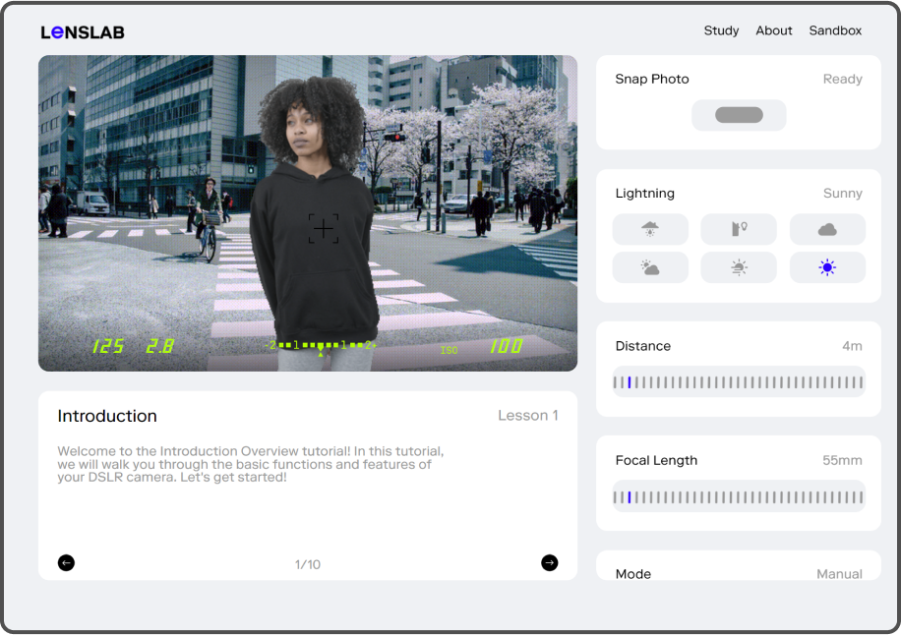
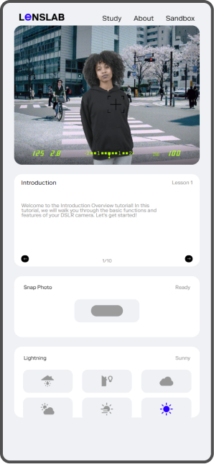
Final Design
LensLab
Ilia Poliakman(id 19021406) | 01.06.2023 | BSc Computing Project | Superviser: Mohamed Bettaz

Slide 16


A training platform that combines theoretical and practical methods of teaching photography
Active Development
Learn the basics of photography!
Ilia Poliakman(id 19021406) | 01.06.2023 | BSc Computing Project | Superviser: Mohamed Bettaz

Slide 17
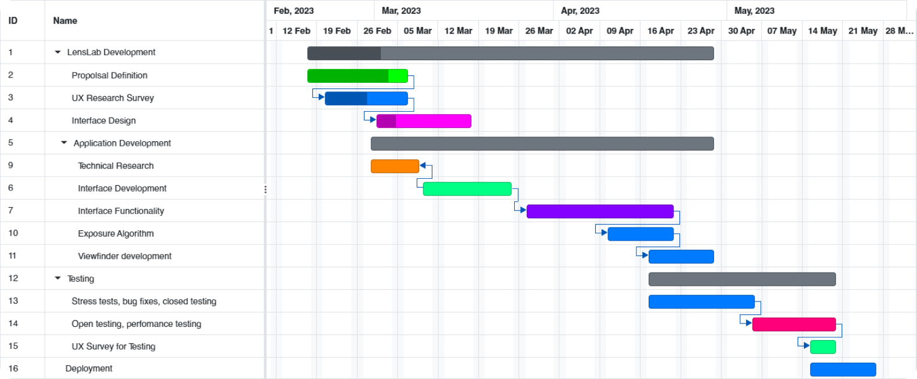
Gantt Chart
Active Development
Ilia Poliakman(id 19021406) | 01.06.2023 | BSc Computing Project | Superviser: Mohamed Bettaz

Slide 18
Important Milestones
Active Development
Exposure Algorithm
Abandonment of frameworks
An algorithm was developed that calculated the EV value based on the user input, which is based on a logarithmic equation. This algorithm helps in training, as well as evaluating the user's work
During development, it was decided not to use large frameworks for the frontend and to keep the implementation in regular JavaScript
The main reason: the desire to keep the minimalism of development, as well as time constraints
Viewfinder & Evaluation
The ability to output the user's result was developed in order to emulate the functions of photographing. The Dom to Image framework is responsible for displaying photos
Ilia Poliakman(id 19021406) | 01.06.2023 | BSc Computing Project | Superviser: Mohamed Bettaz

Slide 19

A training platform that combines theoretical and practical methods of teaching photography
Testing & Deployment
Learn the basics of photography!
Ilia Poliakman(id 19021406) | 01.06.2023 | BSc Computing Project | Superviser: Mohamed Bettaz

Slide 20

Testing Stages
Closed Testing with Technical Consults
Opened testing with Lumiere
Surveys and Focus Groups
Deployment
Ilia Poliakman(id 19021406) | 01.06.2023 | BSc Computing Project | Superviser: Mohamed Bettaz

Slide 21

racerf01.github.io
Ilia Poliakman(id 19021406) | 01.06.2023 | BSc Computing Project | Superviser: Mohamed Bettaz

Slide 22
A training platform that combines theoretical and practical methods of teaching photography
Recommendations
Learn the basics of photography!
Ilia Poliakman(id 19021406) | 01.06.2023 | BSc Computing Project | Superviser: Mohamed Bettaz

Slide 23
Transition to Full-Stack Application
Content Expansion
Enhanced User Interactivity
New study materials
More functionality, better perfomance
New topics and fields
Community and Social Features
Multi-Platform Accessibility
User-generated content
iOS and Android platforms
Integration with Real-World Photography
Feedback loop withusers
Ilia Poliakman(id 19021406) | 01.06.2023 | BSc Computing Project | Superviser: Mohamed Bettaz

Slide 24
Ilia Poliakman(id 19021406) | 01.06.2023 | BSc Computing Project | Superviser: Mohamed Bettaz
Conclusion, Q&A
Learn the basics of photography!
A training platform that combines theoretical and practical methods of teaching photography

